Slide 1


ADVANCED OO
TECHNOLOGY
RYLA STARK

Slide 2
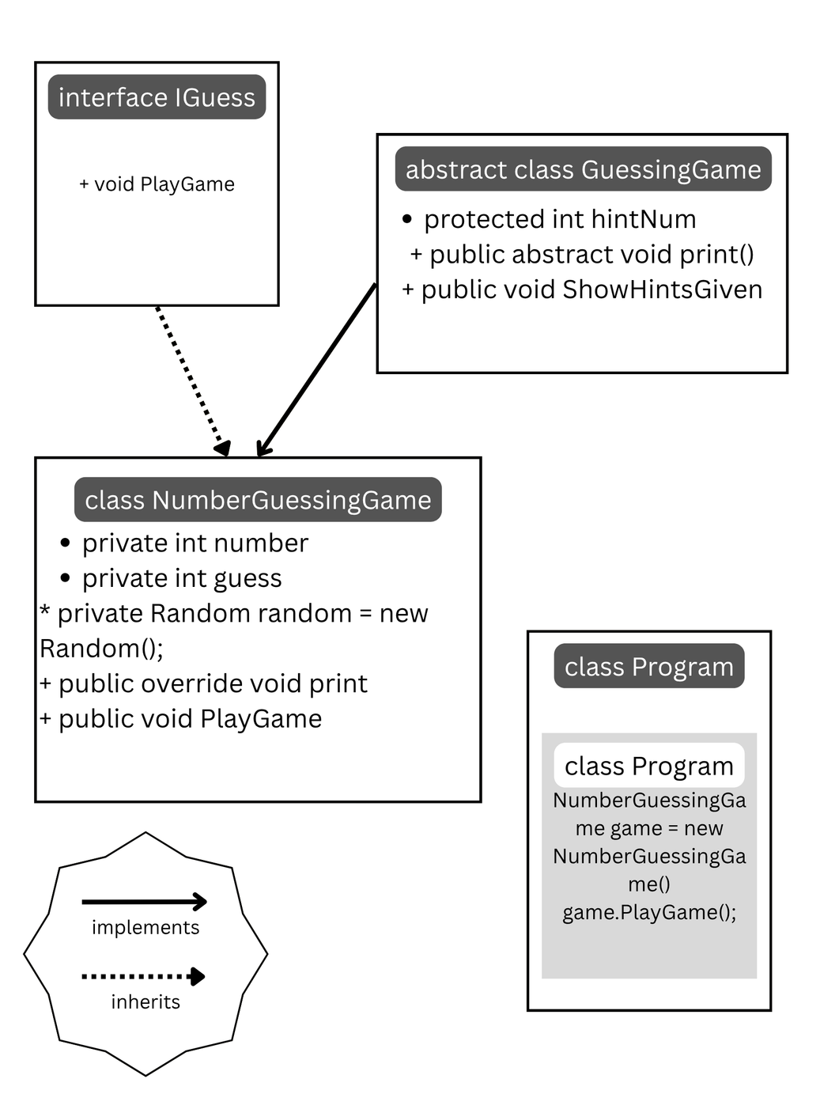
UML

Slide 3

THANK YOU

